Slide 1
The Benefits of learning Cursive Handwriting

Slide 2
Hello!
I am Teacher Marie.
Let the journey begins!

Slide 3
There is a beautiful style of English handwriting called “CURSIVE”
英文書寫體

Slide 4
It was created 170 years ago when people used to write words with quills.
鵝毛筆

Slide 5
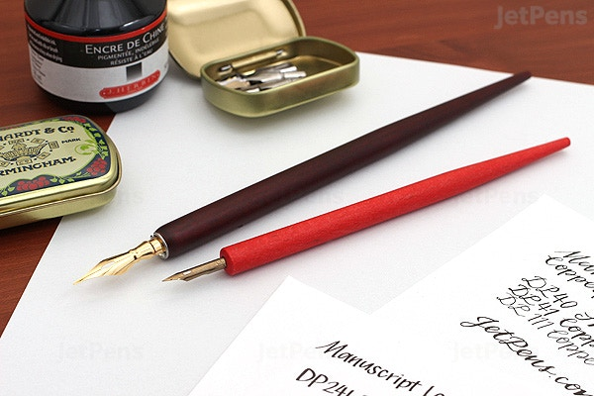
Quills than became dip pens 沾水筆在早期，是繪製漫畫的工具

Slide 6
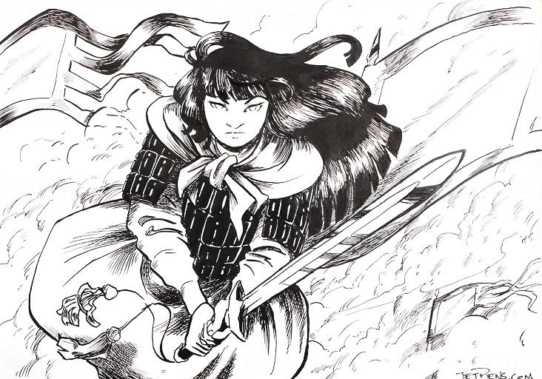

Slide 7
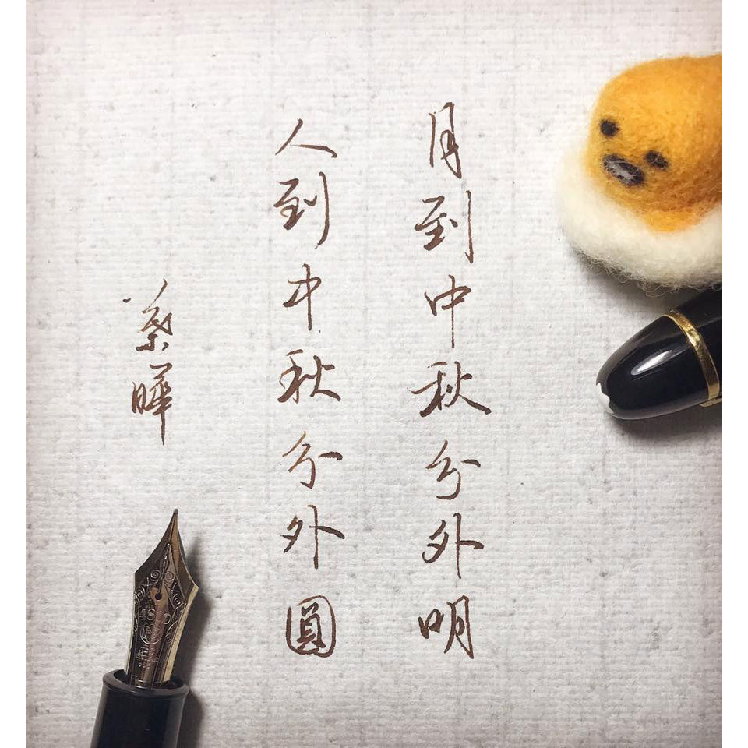
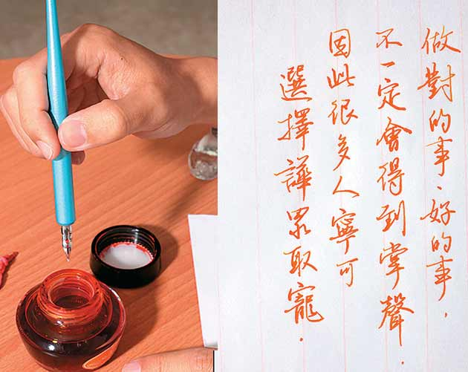
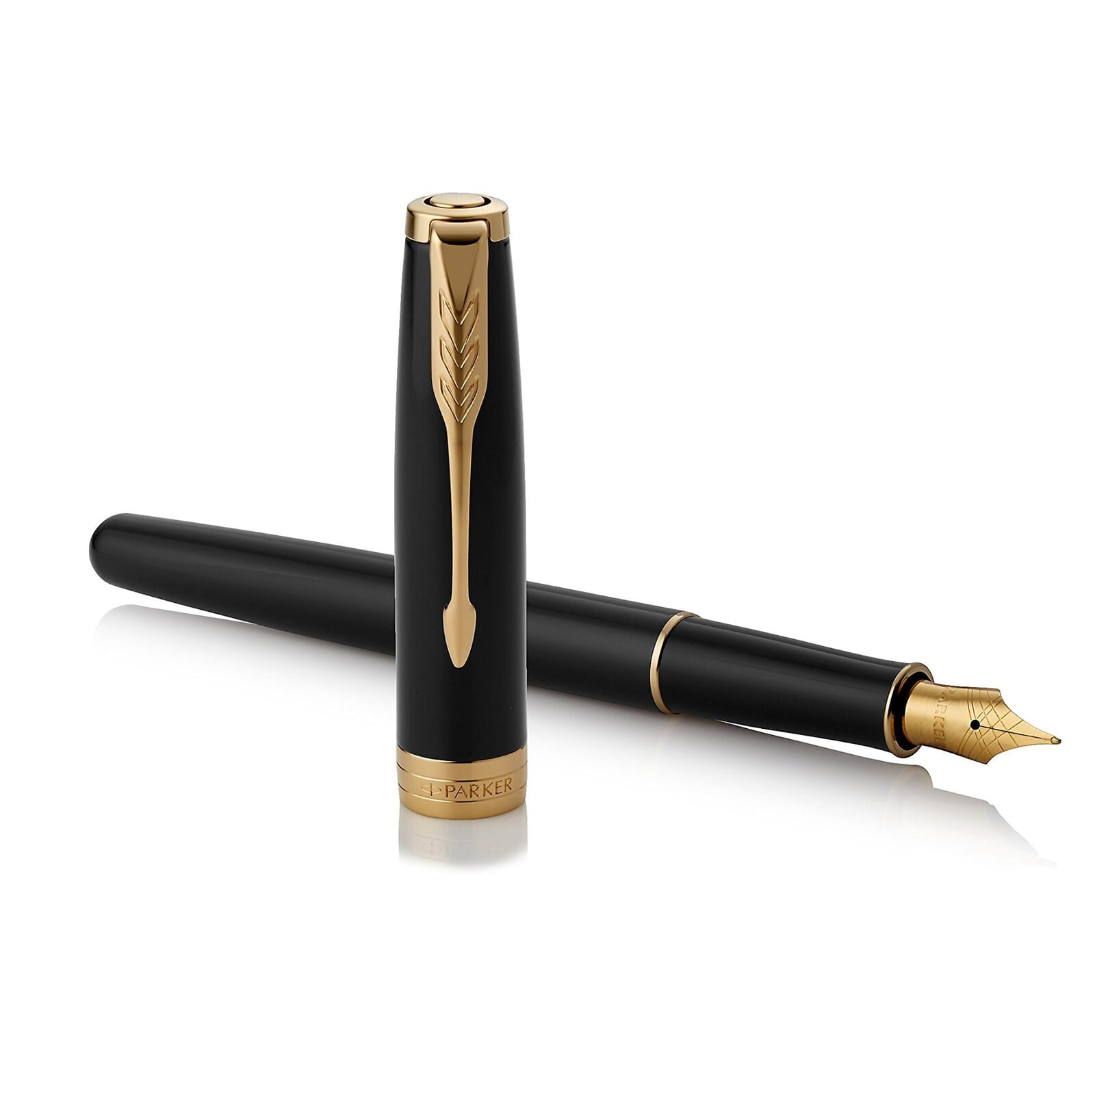
There is also a trend of learning Mandarin Chinese handwriting with pens

Slide 8
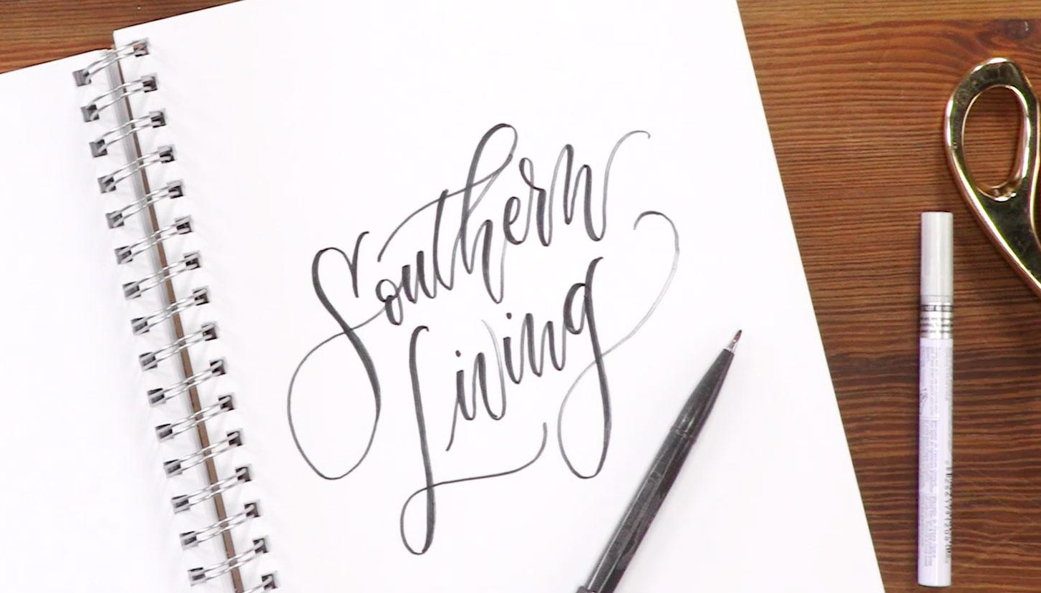
The Benefits of learning cursive
1.
Make your hands cooperate with your brain.
訓練腦部和手的協調。
2.
Being focus.
培養專注力。
3.
Great signature.
簽名變得美美滴。
4.
Being creative.
可以設計美術字。

Slide 9
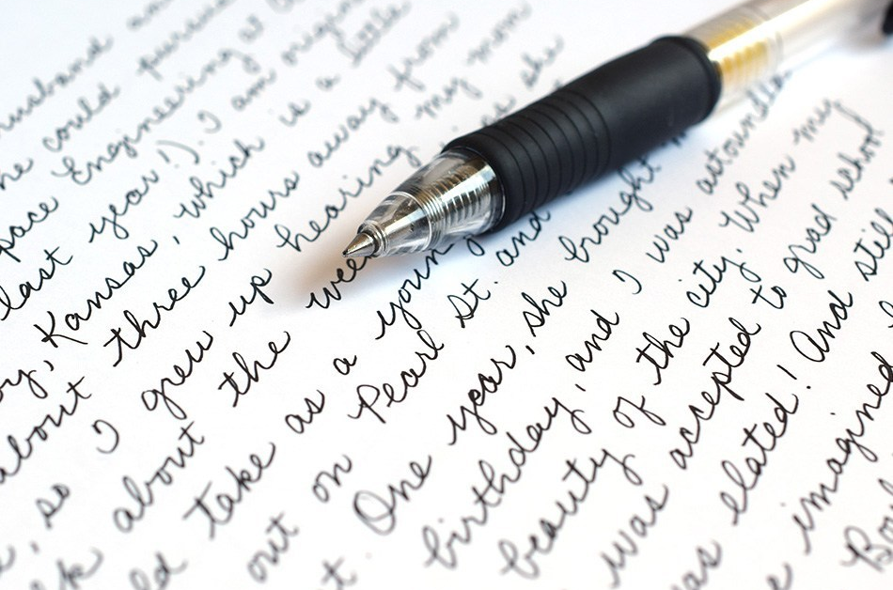
Let the journey begins!

Slide 10
Thanks!
Any questions?

